Slide 1

Microsoft Excel
LECTURE 8

Slide 2
Data Analysis in Microsoft Excel

Slide 3
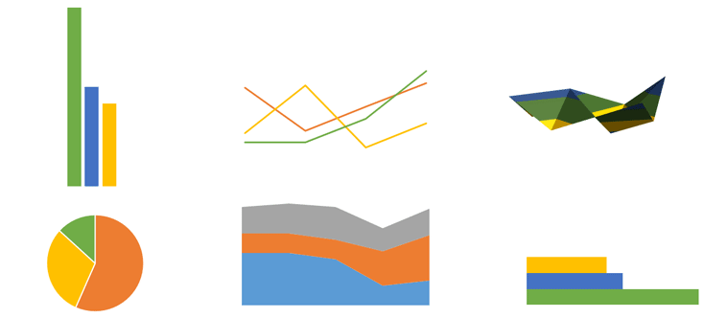
Data analysis using charts
Excel has a variety of chart types, each with its own advantages.

Slide 4
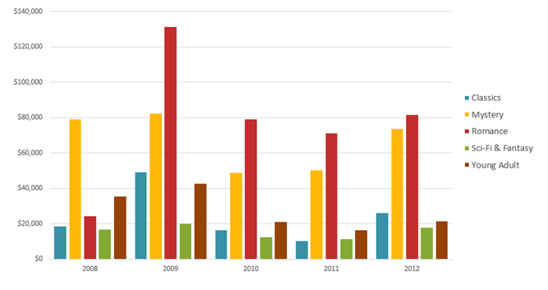
Column chart
Column charts use vertical bars to represent data.
They can work with many different types of data, but they're most frequently used for comparing information.

Slide 5
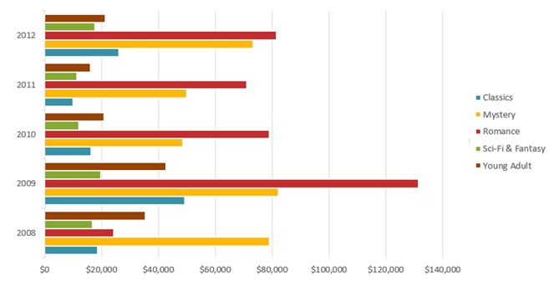
Bar chart
Bar charts work just like column charts, but they use horizontal rather than vertical bars.

Slide 6
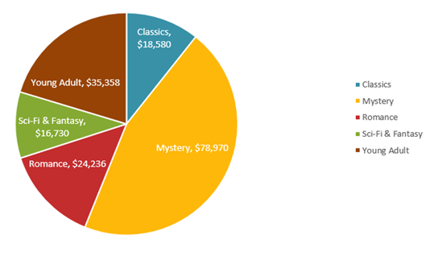
Pie chart
Pie charts make it easy to compare proportions.
Each value is shown as a slice of the pie, so it's easy to see which values make up the percentage of a whole.

Slide 7
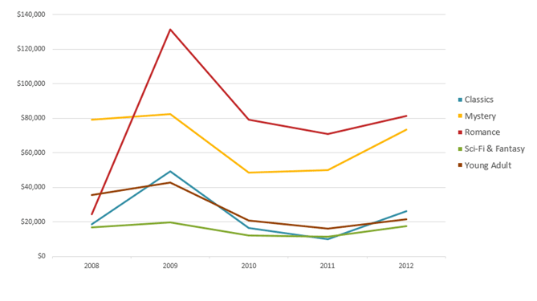
Line chart
Line charts are ideal for showing trends.
The data points are connected with lines, making it easy to see whether values are increasing or decreasing over time.

Slide 8
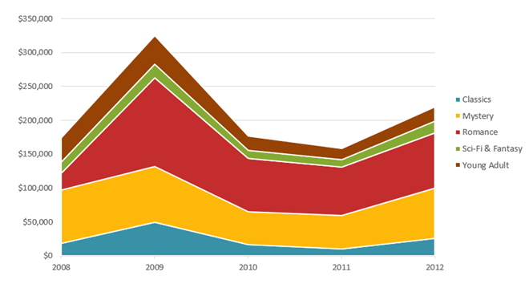
Area chart
Area charts are similar to line charts, except the areas under the lines are filled in.

Slide 9
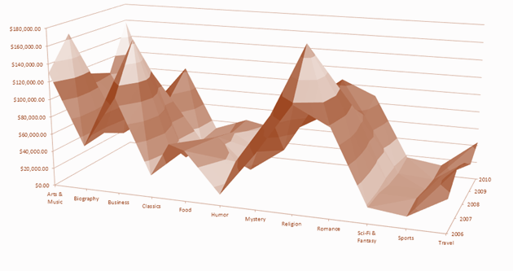
Surface chart
Surface charts allow you to display data across a 3D landscape.
They work best with large data sets, allowing you to see a variety of information at the same time.

Slide 10
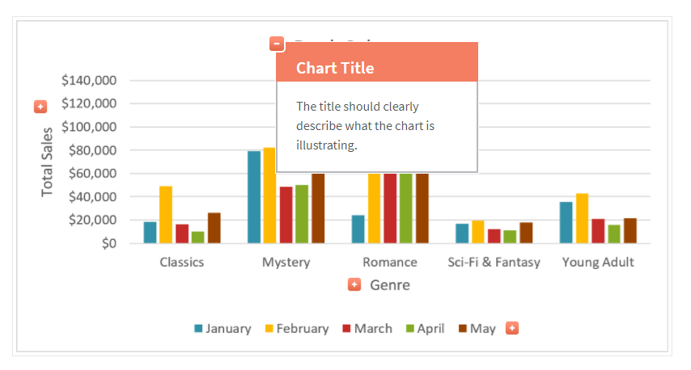
Chart Title

Slide 11
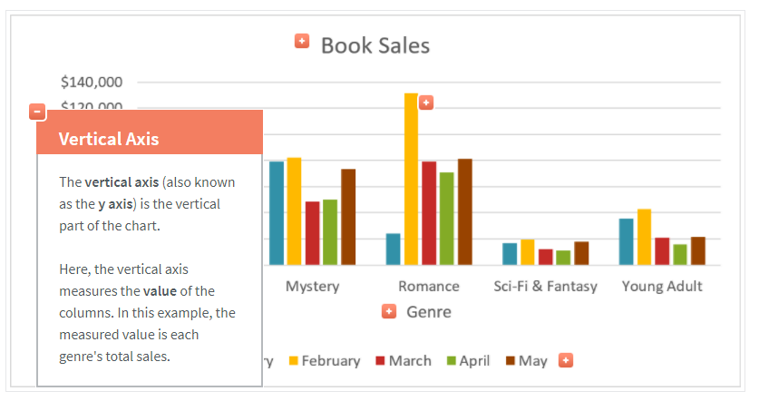
Vertical Axis

Slide 12
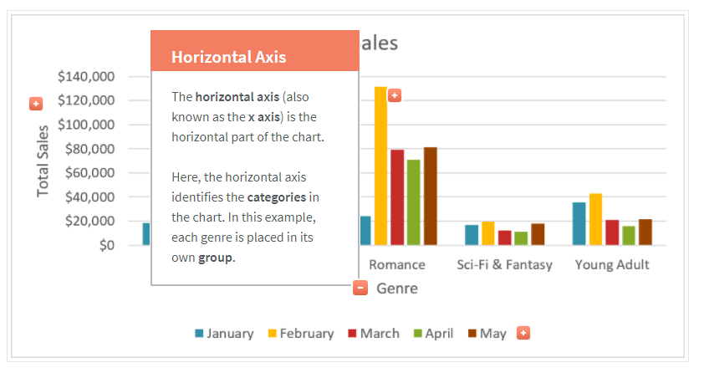
Horizontal Axis

Slide 13
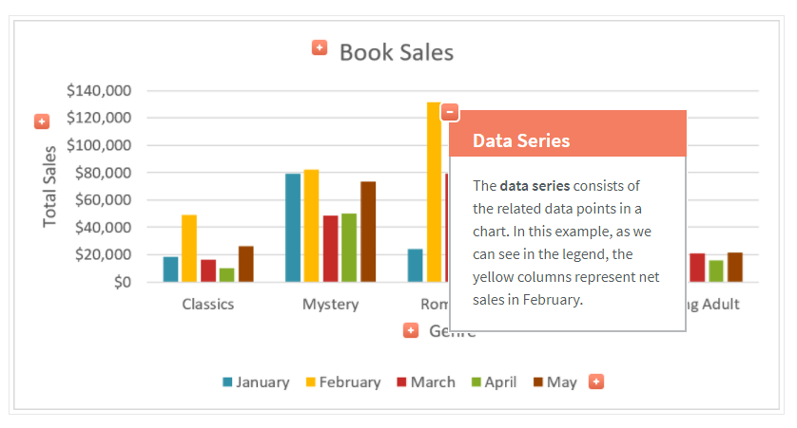
Data Series

Slide 14
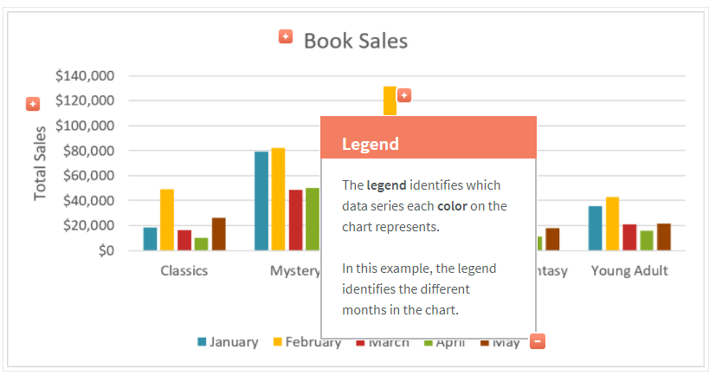
Legend

Slide 15
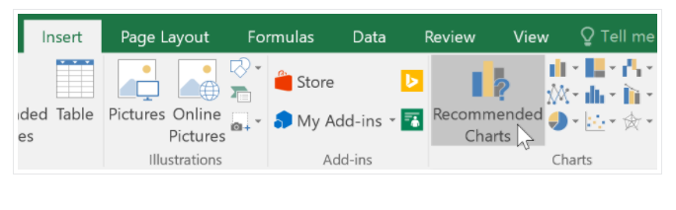
Tips
If you're not sure which type of chart to use, the Recommended Charts command will suggest several different charts based on the source data.

Slide 16
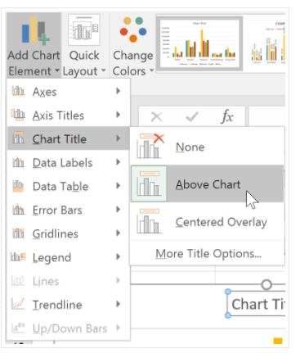
Tips
Excel allows you to add chart elements—such as chart titles, legends, and data labels—to make your chart easier to read.

Slide 17
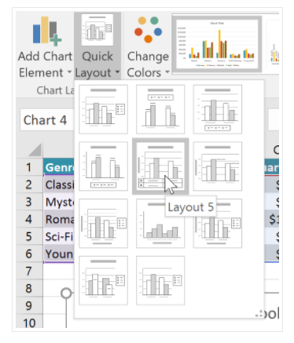
Tips
If you don't want to add chart elements individually, you can use one of Excel's predefined layouts.

Slide 18
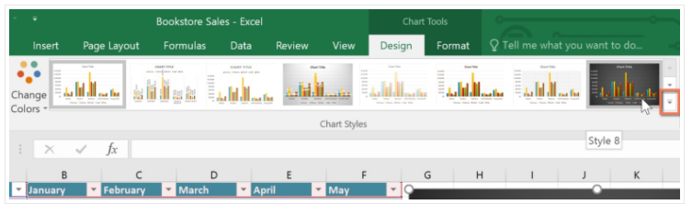
Tips
Excel also includes several chart styles, which allow you to quickly modify the look and feel of your chart.

Slide 19
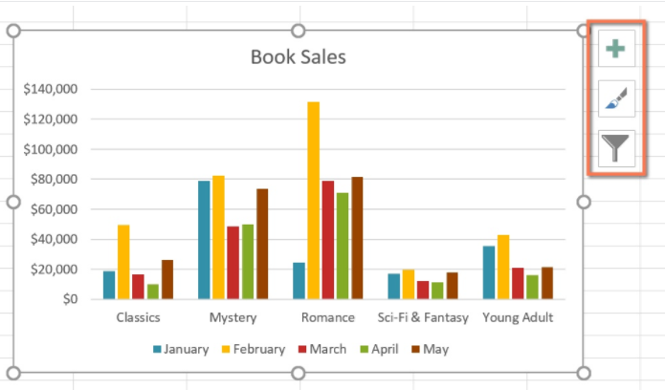
Tips
You can also use the chart formatting shortcut buttons to quickly add chart elements, change the chart style, and filter the chart data.

Slide 20
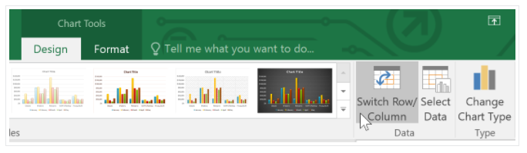
Switch row and column data
Sometimes you may want to change the way charts group your data.

Slide 21
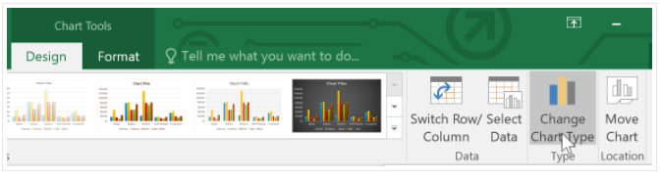
Change the chart type
If you find that your data isn't well suited to a certain chart, it's easy to switch to a new chart type.

Slide 22
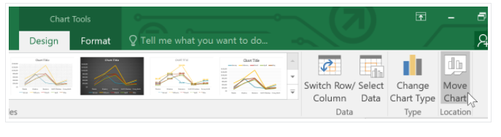
To move a chart
Whenever you insert a new chart, it will appear as an object on the same worksheet that contains its source data.
Alternatively, you can move the chart to a new worksheet to help keep your data organized.

Slide 23
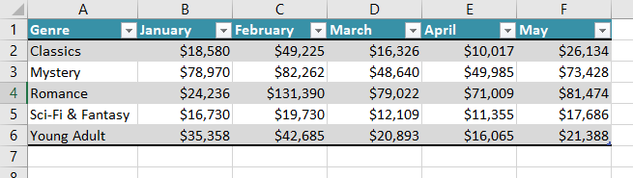
Activity 1
Create a new excel workbook and rename it as “Charts activity”.
Rename the sheet 1 as “Fiction Book Sale”.
Create the below table on Fiction book sale worksheet.

Slide 24
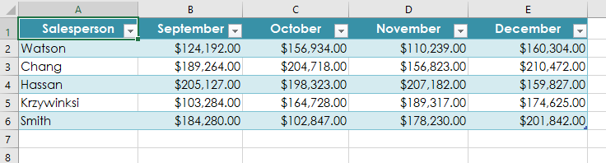
4. Add another worksheet on the same workbook and rename it as “Challenge”.
5. Create the below table on Challenge worksheet.
6. Select cells A1:E6 in the challenge tab and insert a 2D Clustered Column chart.
7. Change the chart title to “September to December Sales”.
8. Use the Switch Row/Column command. The columns should now be grouped by month, with a different color for each salesperson.
9. Move the chart to a new sheet.

Slide 25
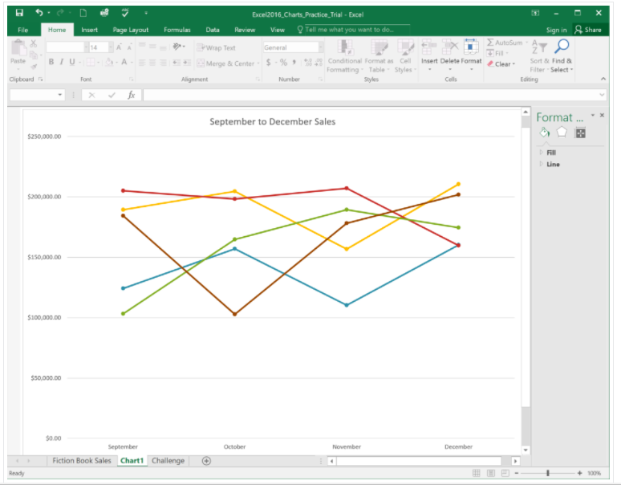
10. Change the chart type to line with markers.
11. Use the Quick Layout command to change the layout of the chart.
12. When you're finished, your workbook should look something like this:

Slide 26
Pivot Table

Slide 27
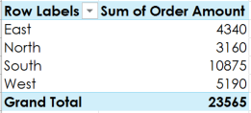
Activity 2
1. Open the practice workbook.
2. Create a PivotTable in a separate sheet.
3. We want to answer the question What is the total amount sold in each region? To do this, select Region and Order Amount. When you're finished, your workbook should look like this:
4. In the Rows area, remove Region and replace it with Salesperson.
5. Add Month to the Columns area.

Slide 28
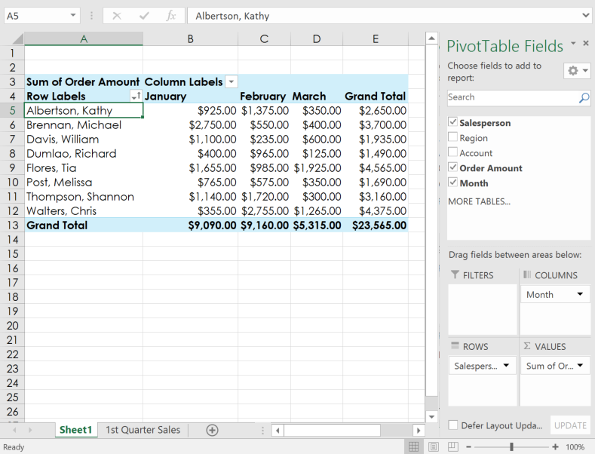
6. Change the number format of cells B5:E13 to Currency. Note: You might have to make columns C and D wider in order to see the values.
7. When you're finished, your workbook should look like this:

Slide 29
Pivot Chart

Slide 30
Activity 3
1. Open the practice workbook.
2. In the Rows area, remove Region and replace it with Salesperson.
3. Insert a PivotChart, and choose the type Line with Markers.
4. Insert a slicer for Regions.
5. Use the slicer to only show the South and East regions.
6. Change the PivotChart type to Stacked Column.
7. In the PivotChart Fields pane to the right, add Month to the Legend (Series) area. Note: You can also click the PivotTable and then add Month to the Columns area; the result will be the same.

Slide 31
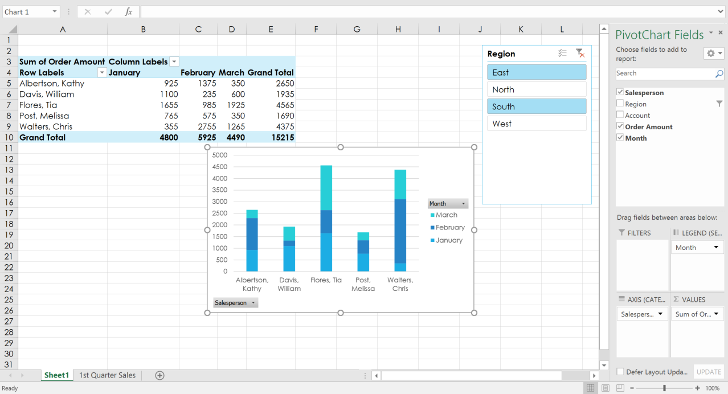
8. When you're finished, your workbook should look something like this:

